Slide 1
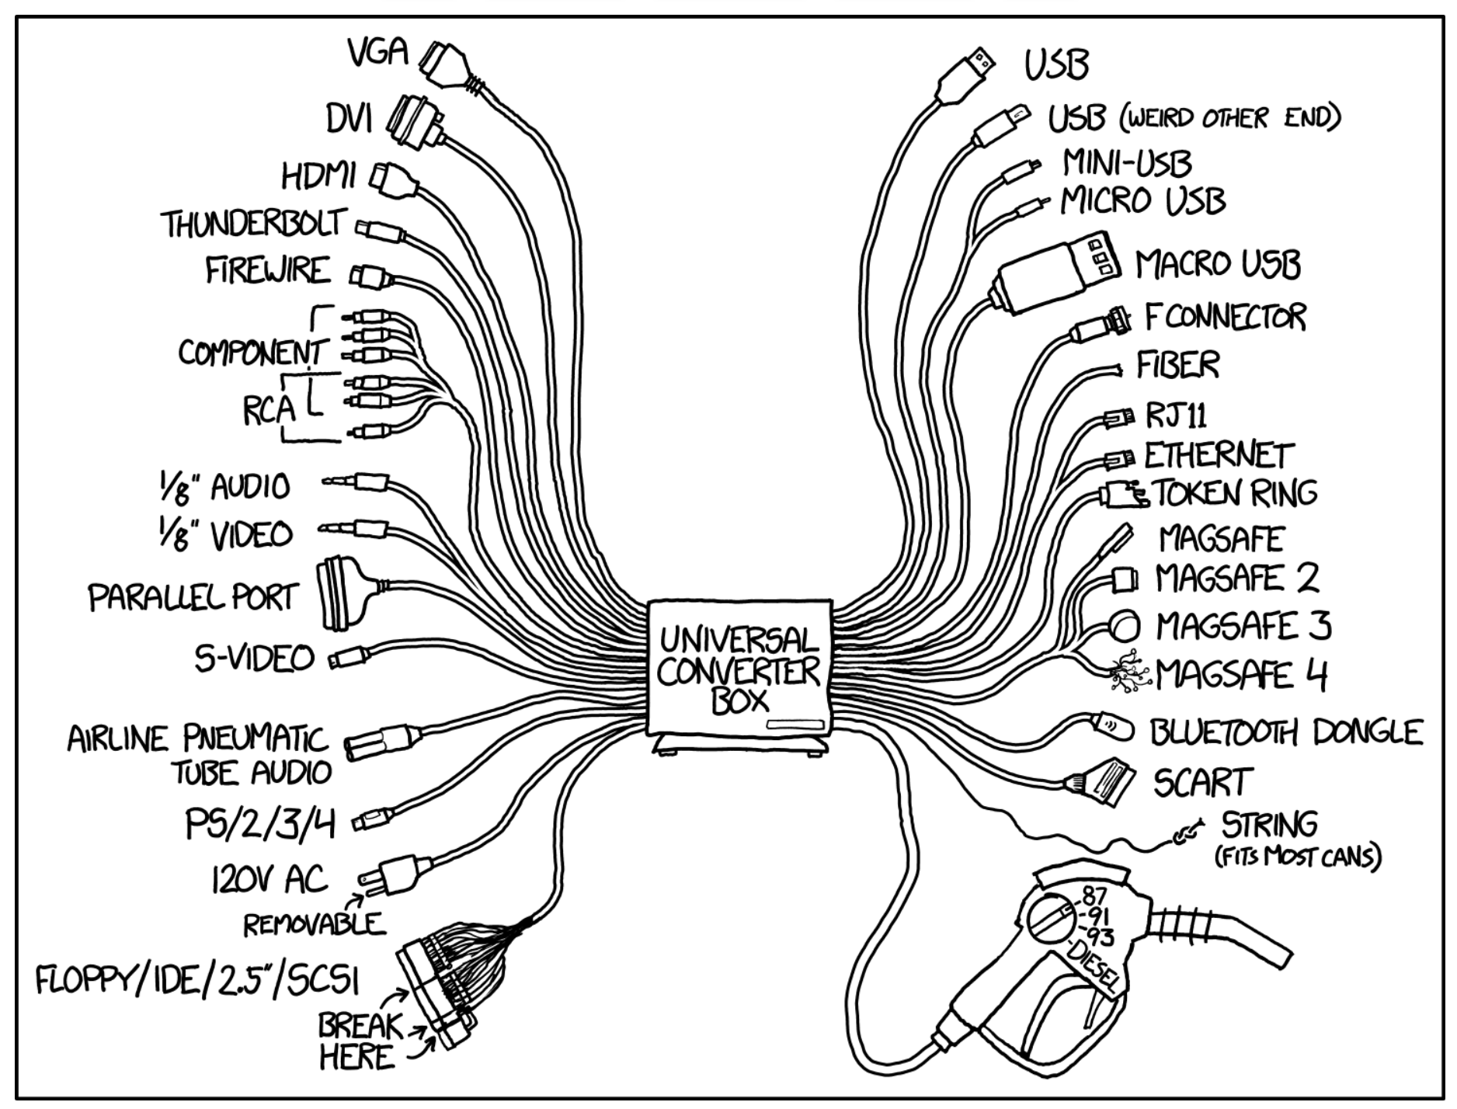
System-level Communication
https://xkcd.com/1406/

Slide 2
Computer System Technologies
What is the most important part of this picture?
DRAM
Hard Disk
Drives
Linux
Windows
10
Motherboards
SDRAM
LAN technology
Flash Memory
ActiveX
Controls
Graphics
Acceleration
App
Servers

Slide 3
Technology comes & goes; interfaces last forever
Interfaces typically deserve more engineering attention than the technologies they interface…
Abstraction: should outlast many technology generations
Often “virtualized” to extend beyond original function (e.g. memory, I/O, services, machines)
Represent more potential value to their proprietors than the technologies they connect.
Interface sob stories:
Interface “warts”: Big/little Endian wars
Early IBM PC reliance on the exact signaling of 8086 chips
... and many success stories:
IBM 360 Instruction set architecture; Postscript; Compact Flash; ...
TCP/IP-based packet networks

Slide 4
System Interfaces & Modularity
Ancient Times (Ad hoc connections)
MEM
MEM
I/O
Late 60s (Processor-dependent Bus)
CPU
I/O
CPU
DISK
DISK
I/O
MEM
MEM
I/O
80s (Processor-independent Bus)
CPU
DISK
I/O
90s (buses galore)
Graphics I/O
MEM
MEM
CPU
I/O
MEM
PCIe lanes
Bridge
CPU L2/L3 $
DISK
I/O
I/O
(Mostly) Point-to-point

Slide 5
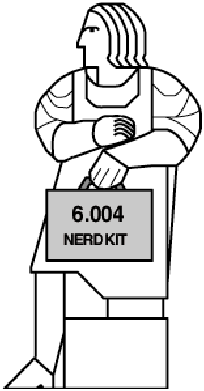
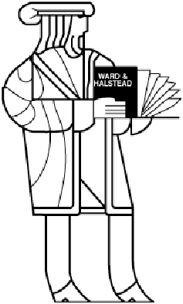
Buses, Interconnect, So…?
Aren’t communication channels simply logic circuits with long wires?
Wires − circuit theorist’s view:
Equipotential “nodes” of a circuit.
Instant propagation of v, i over entire node.
“distance” abstracted out of design model.
Time issues dictated by RLC elements; wires are timeless.
Wires − interconnect engineer’s view:
Transmission lines.
Finite signal propagation velocity.
Distance matters.
Time matters.
Reality matters.

Slide 6
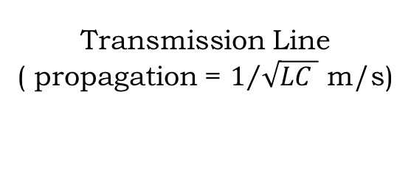
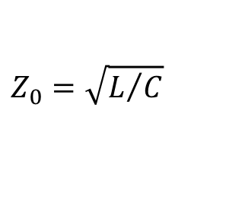
Electrical Model for Real Wires
Transmission Line
( propagation = $1/{\sqrt{LC }}$ m/s)
signal
≡
Reference (e.g., ground)
Z₀
$$Z_{0}=\sqrt{L/C}$$
(At high frequency)
Omegatron (CC BY-SA 3.0)
 | Description | On chip | On PCB
R | Resistance of conductor | 150kΩ/m | 5Ω/m
L | Self-inductance of conductor (due to magnetic field induced by current) | 600nH/m | 300nH/m
C | Capacitance between signal and ground | 200pF/m | 100pF/m
G | Conductance between signal and ground (through insulator) | small | small
http://cva.stanford.edu/books/dig_sys_engr/lectures/
Notes:
https://en.wikipedia.org/wiki/Transmission_li
http://cva.stanford.edu/books/dig_sys_engr/lectures/l2.pdfne#/media/File:Transmission_line_element.svg

Slide 7
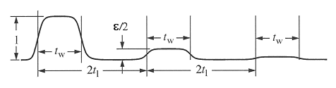
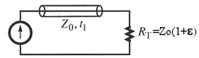
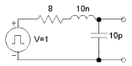
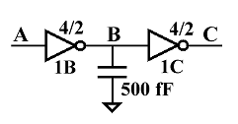
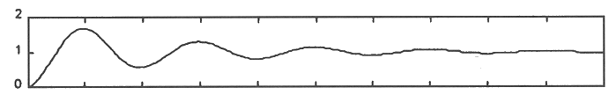
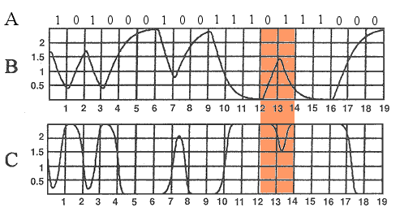
Real-World Consequences
∆V from energy storage left over from earlier signaling on the wire:
• transmission line discontinuities (reflections off of impedance mismatches and terminations)
[Dally]Fig. 6-17
• charge storage in RC circuit
(narrow pulses are lost due to incomplete transitions)
• RLC ringing (triggered by voltage steps)
[Dally]Fig. 6-19
Fix: slower operation, limiting
voltage swings and slew rates
Dally, W.J., Poulton, J. W., Digital Systems Engineering, 1998
[Dally]Fig. 6-20

Slide 8
Space & Time Constraints
Fundamental Physical Constraints:
Bounds on propagation speeds
Signals travel ~18cm/ns on PCB
Bounds on device density
Must be finite distances between components
Bounds on flow of charge
finite currents → finite rise/fall times
wire delays depend on loading
Space
Communication
Storage
Time
Moving information in space/time

Slide 9
Gates, Wires, & Delays
Our t_{pd}, t_{cd} timing model
bundles delays into device specs
ignores loading, wire lengths
A
B
Reality check:
long / heavily-loaded outputs will be slower
can bundle internal wire delays into t_{pd} of a device; but external load matters!
partial fixes: buffers, distribution trees
optimizing performance requires attention to loading issues (You’ll see this in the design project!).
32
Particularly problematic: system-wide interconnect!

Slide 10
Interface Standard: Backplane Bus
Modular cards that plug into a common backplane:
CPUs
Memories
Bulk storage
I/O devices
S/W?
The backplane provides:
Power
Common system clock
Wires for communication
Notes:
MOST COMMON communication technology WITHIN a computer... BACKPLANE BUS.
Single-Bus Organization pioneered by DEC in mid 60s... multiple buses common too.
MODULES, ADDRESS ASSIGNMENTS, PROTOCOLS...
All modules SHARE bussed lines.
*** SHOW EXAMPLES ***
START/FINISH: Locally Timed (Self Timed) protocols.
GENERALIZATION of memory read/write protocols.

Slide 11
A Parallel Bus Transaction
ORIGINATOR:
1) Chooses bus operation
2) Asserts an address
3) Waits for a recipient to answer.
sample edge
assertion edge
CLK
start
(Originator)
RECIPIENT:
1) Monitors start
2) Check address
3) If meant for me
a) look at bus operation
b) do operation
c) signal finish of cycle
finish
(Recipient)
operation
WRITE (Originator)
address
(Originator)
BUS:
1) Monitors start 2) Start count down
3) If no one answers before
counter reaches 0 then
“time out”
data
(Originator)

Slide 12
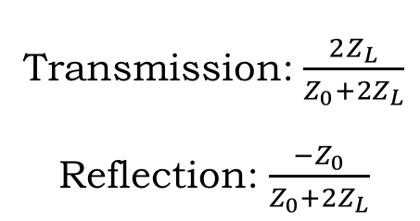
Bus Lines as Transmission Lines
Spinningspark (CC BY-SA 3.0)
?
?
?
?
Transmission: $\frac{2Z_{L}}{Z_{0}+2Z_{L}}$
Reflection: $\frac{−Z_{0}}{Z_{0}+2Z_{L}}$
ANALOG ISSUES:
Propagation times
Signals travel at ~18 cm/ns on a PCB
Skew
Different points along the bus see the signals at different times
Bits of data propagate at slightly different rates along parallel wires
Reflections & standing waves
At each interface (places where the propagation medium changes) the signal may reflect if the impedances are not matched.
Make a transition on a long line – may have to wait many transition times for echoes to subside.
https://en.wikipedia.org/wiki/Reflections_of_signals_on_conducting_lines
Notes:
https://en.wikipedia.org/wiki/Reflections_of_signals_on_conducting_lines#/media/File:Discontinuity_on_transmission_line.svg

Slide 13
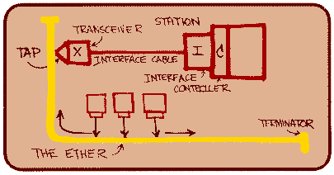
Meanwhile, Outside the Box…
The network as an interface standard.
ETHERNET: In the mid-70’s Bob Metcalf (at Xerox PARC, an MIT alum) devised a bus for networking computers together.
IDEA: Protocol “layers” that isolate application-level interface from low-level physical devices:
Application
Session
Inspired by Aloha net (radio)
COAX replaced “ether”
Bit-serial (optimized for long wires)
Variable-length “packets”:
- self-clocked data (no clock, skew!)
- header (dest), data bits, checksum
Issues: sharing, contention, arbitration, “backoff”
TCP
UDP
Transport
Network
IP
Physical
Ethernet
Token Ring

Slide 14
Lessons learned: single driver, point-to-point
Differential signaling over controlled impedance trace
BEST
Z₀
Match impedance of driver to impedance of trace
Single-ended signaling over controlled impedance trace
OKAY
Z₀
Match impedance of driver to impedance of trace
SLOW
Z₀
Z₀
Issues:
Impedance troubles when driving in middle
Turn-around time when sharing a wire (wired-or glitch)

Slide 15
Lessons learned: clock recovery
Receive samples
Inferred clock edges
Extrapolated clock edges
(Sample period)(# samples/bit)
Receiver can infer presence of clock edge every time there’s a transition in the received samples.
Using sample period, extrapolate remaining edges
-- Now know first and last sample for each bit -- Choose “middle” sample to determine message bit
Can’t go too long without a clock edge → 8b10b encoding

Slide 16
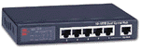
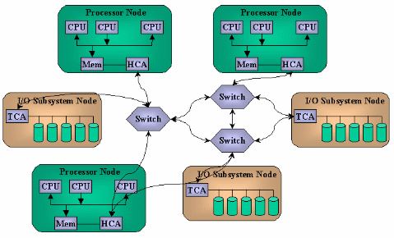
Serial, Point-to-Point Communications
ETHERNET: Broadcast technology
Sharing (contention) issues
Multiple-drop-point issues…
bit-serial (single wire!)
“Packets” for multi-bit data
Evolution: Point-to-point
10BaseT, separate R & T wires
Each link connects only 2 hosts, one sends, the other receives
Network riddled with switches, routers
Serial point-to-point bus replacements
Multi Gbit/sec serial links!
PCIe, Infiniband, SATA, USB, ...
Packets, headers
Switches, routing
Trend: localized, superfast, serial networks!

Slide 17
Improving on the bus: lessons learned from the network world
Bus issues:
shared medium → arbitrate between requesters
clock skew → parallel bit lines, variable timings
multiple originators → turnaround time
impedance discontinuities, stubs → reflections
O
R
REPLACEMENT: fast unidirectional serial point-to-point link
one transmitter, one receiver → no arbitration, no turnaround
serial packets replace parallel wire bundles
clock recovered from data bits → no skew problems
unidirectional, point-to-point → good signal quality
need more throughput? → use multiple serial links in parallel…
need many-to-many communication? → switches (like Ethernet)
complex interface → Moore’s law to the rescue!
O
R
1x
O
R
4x

Slide 18

Communications in Today’s Computers
QuickPath Interconnect:
→ 20 data + clk
← 20 data + clk
Differential signaling
6.4 GT/s
One bus to rule them all,
One bus to join them,
One bus to bring them all
And to the CPU bind them.
Notes:
https://en.wikipedia.org/wiki/Intel_X58#/media/File:X58_Block_Diagram.png

Slide 19
Example serial link: PCI Express (PCIe)
Physical Layer (v2.0)
I = ±3.5mA
8b/10b
Encoded
Data
@ 5Gb/s
8b/10b
Encoded
Data
LVDS
SIGNALING
RT = 100Ω
V = ±350mV
Differential
Transmitter
Differential
Receiver
PCIe x1: one differential pair in each direction, also x2, x4, x8, …, x32
Data is organized into packets:
TRAIN
“START”
DLL payload
“END”
Data Link Layer
2-byte
SEQNUM
TL payload
4-byte
LCRC
Transaction Layer
16- or 20-byte
HEADER
0 to 4096 data bytes

Slide 20
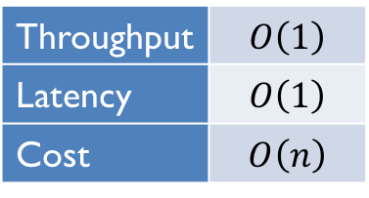
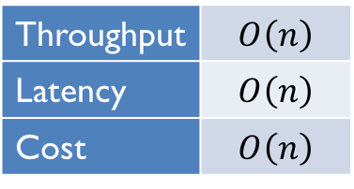
Communication Topologies asymptotic cost/performance tradeoffs
Goal: enable communications between n components
Each point-to-point link requires one hardware unit.
Each point-to-point communication requires one time unit.
Each link operates independently
1-dimensional approaches:
BUS
Shared communication channel allows only one message at a time
Throughput | $$O\left(1\right)$$
Latency | $$O\left(1\right)$$
Cost | $$O\left(n\right)$$
RING
Each component has link to next component on ring
Throughput | $$O\left(n\right)$$
Latency | $$O\left(n\right)$$
Cost | $$O\left(n\right)$$
Notes:
How to connect things? Gross block diagrams (topologies). Examine
LATENCY for n nodes;
THRUPUT for n nodes;
COST for n nodes.
Connect everything to everything: engineering overkill.
n(n-1) links - each requires a wire plus 2 interfaces.
O(n**2) cost;
O(n) latency (assuming constant size links);
O(n) msgs/sec thruput.
Be more systematic: 2D Crossbar
... still quadratic cost.

Slide 21
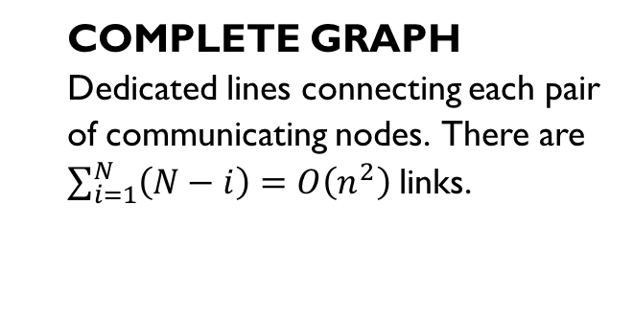
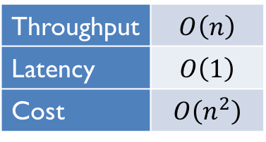
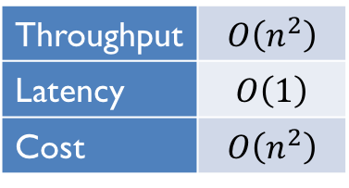
Quadratic-cost Topologies
COMPLETE GRAPH
Dedicated lines connecting each pair of communicating nodes. There are $\sum_{i=1}^{N}{\left(N−i\right)=O\left(n^{2}\right)}$ links.
Throughput | $$O\left(n^{2}\right)$$
Latency | $$O\left(1\right)$$
Cost | $$O\left(n^{2}\right)$$
CROSSBAR SWITCH
Switch dedicated between each pair of nodes
Each A_{i} can be connected to one B_{j} at any time
Special cases:
A = processors, B = memories
A, B same type of node
A, B same nodes (complete graph)
Throughput | $$O\left(n\right)$$
Latency | $$O\left(1\right)$$
Cost | $$O\left(n^{2}\right)$$
Notes:
How to connect things? Gross block diagrams (topologies). Examine
LATENCY for n nodes;
THRUPUT for n nodes;
COST for n nodes.
Connect everything to everything: engineering overkill.
n(n-1) links - each requires a wire plus 2 interfaces.
O(n**2) cost;
O(n) latency (assuming constant size links);
O(n) msgs/sec thruput.
Be more systematic: 2D Crossbar
... still quadratic cost.

Slide 22

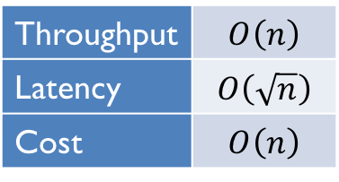
Mesh Topologies
2-Dimensional Meshes
Throughput | $$O\left(n\right)$$
Latency | $$O\left(\sqrt{n}\right)$$
Cost | $$O\left(n\right)$$
4-Neighbor
8-Neighbor
Nearest-neighbor connectivity:
Point-to-point interconnect
- minimizes delays
- minimizes “analog” effects
Store-and-forward
(some overhead associated with communication routing)
Throughput | $$O\left(n\right)$$
Latency | $$O\left(\sqrt[3]{n}\right)$$
Cost | $$O\left(n\right)$$
3-D, 6-Neighbor Mesh
Notes:
Reach O(k**2) nodes in k steps --
Latency for n=k**2 nodes is k.
Doesnt matter much what the local connectivity is; 4N, 8N about same.
NICE Property of 3D Mesh: can be implemented in 3D space!

Slide 23
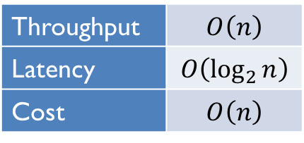
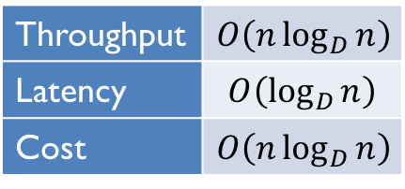
Logarithmic-latency Networks
HYPERCUBE
D dimensions → 2^{D} nodes
Each node has D links
Throughput | $$O\left(n\log_{D}{n}\right)$$
Latency | $$O\left(\log_{D}{n}\right)$$
Cost | $$O\left(n\log_{D}{n}\right)$$
BINARY TREE
Throughput | $$O\left(n\right)$$
Latency | $$O\left(\log_{2}{n}\right)$$
Cost | $$O\left(n\right)$$
Notes:
BINARY TREE: 3 ports/node.
Generalization of CUBE to arbitrarily many dimensions.

Slide 24
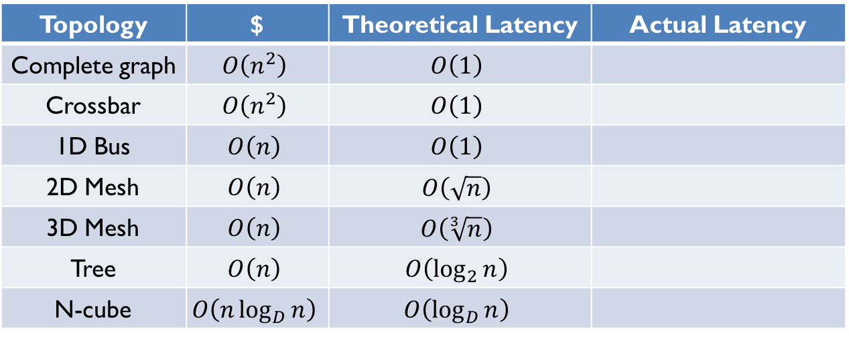
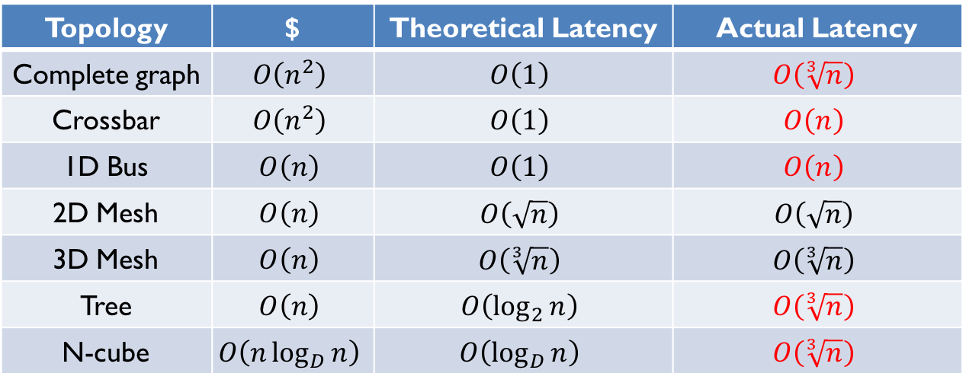
Communication Technologies: Latency
Theorist's view:
Each point-to-point link requires one hardware unit.
Each point-to-point communication requires one time unit.
Topology | $ | Theoretical Latency | Actual Latency
Complete graph | $$O\left(n^{2}\right)$$ | $$O\left(1\right)$$
Crossbar | $$O\left(n^{2}\right)$$ | $$O\left(1\right)$$
1D Bus | $$O\left(n\right)$$ | $$O\left(1\right)$$
2D Mesh | $$O\left(n\right)$$ | $$O\left(\sqrt{n}\right)$$
3D Mesh | $$O\left(n\right)$$ | $$O\left(\sqrt[3]{n}\right)$$
Tree | $$O\left(n\right)$$ | $$O\left(\log_{2}{n}\right)$$
N-cube | $$O\left(n\log_{D}{n}\right)$$ | $$O\left(\log_{D}{n}\right)$$
Topology | $ | Theoretical Latency | Actual Latency
Complete graph | $$O\left(n^{2}\right)$$ | $$O\left(1\right)$$ | $$O\left(\sqrt[3]{n}\right)$$
Crossbar | $$O\left(n^{2}\right)$$ | $$O\left(1\right)$$ | $$O\left(n\right)$$
1D Bus | $$O\left(n\right)$$ | $$O\left(1\right)$$ | $$O\left(n\right)$$
2D Mesh | $$O\left(n\right)$$ | $$O\left(\sqrt{n}\right)$$ | $$O\left(\sqrt{n}\right)$$
3D Mesh | $$O\left(n\right)$$ | $$O\left(\sqrt[3]{n}\right)$$ | $$O\left(\sqrt[3]{n}\right)$$
Tree | $$O\left(n\right)$$ | $$O\left(\log_{2}{n}\right)$$ | $$O\left(\sqrt[3]{n}\right)$$
N-cube | $$O\left(n\log_{D}{n}\right)$$ | $$O\left(\log_{D}{n}\right)$$ | $$O\left(\sqrt[3]{n}\right)$$
Engineer’s view:
Loading increases with number of connections (bus, crossbar)
Nodes have size: limits possible 2D, 3D density (other topologies)
Notes:
OFTEN, topologies characterized by simple assumptions...
POPULAR HANGUP on worst-case latency!

Slide 25
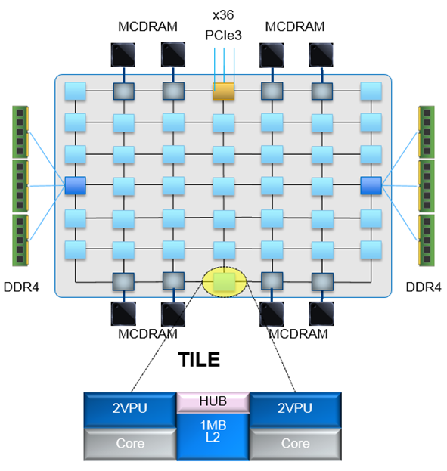
Communications Futures
Backplane buses have evolved into point-to-point links
+ links operate independently
+ links can be managed in groups
+ packetized data deals with errors
Specialized buses for memory
Networked “peripherals” for mobile devices…
New-generation communications...
• how should 100 (1000?) cores communicate?
SATA
FireWire
EISA
DDR
NuBus
PCI
SDRAM
SBUS
USB

